Slide 1
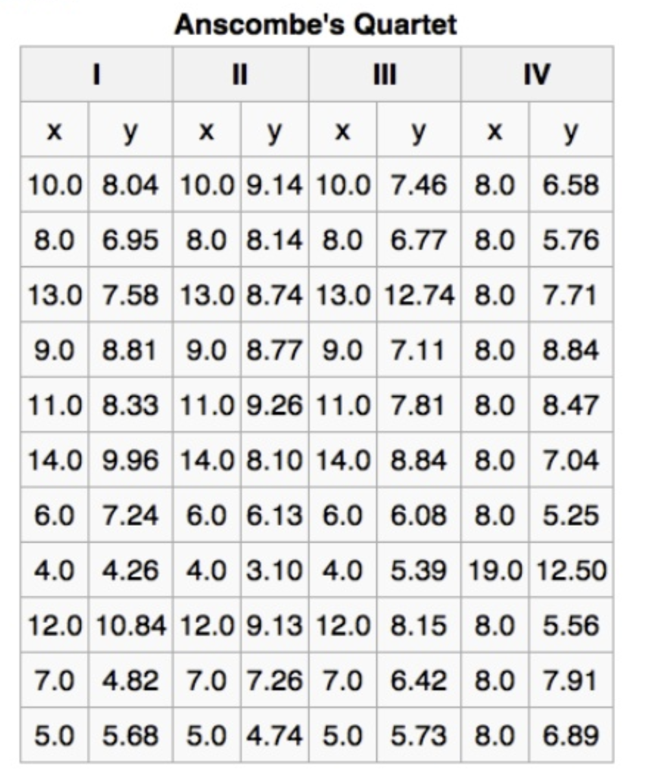


Activity 1: Make a scatterplot for each data set
Activity 2: Make some general statements about what is happening in each graph.
https://en.wikipedia.org/wiki/Anscombe%27s_quartet
Visualization – Trieste 2025
Notes:
Anscombe’s quartet is a set of four datasets that have nearly identical summary statistics, but very different visual patterns. This teaches us the importance of visualizing data instead of relying solely on summary statistics when exploring data

Slide 2
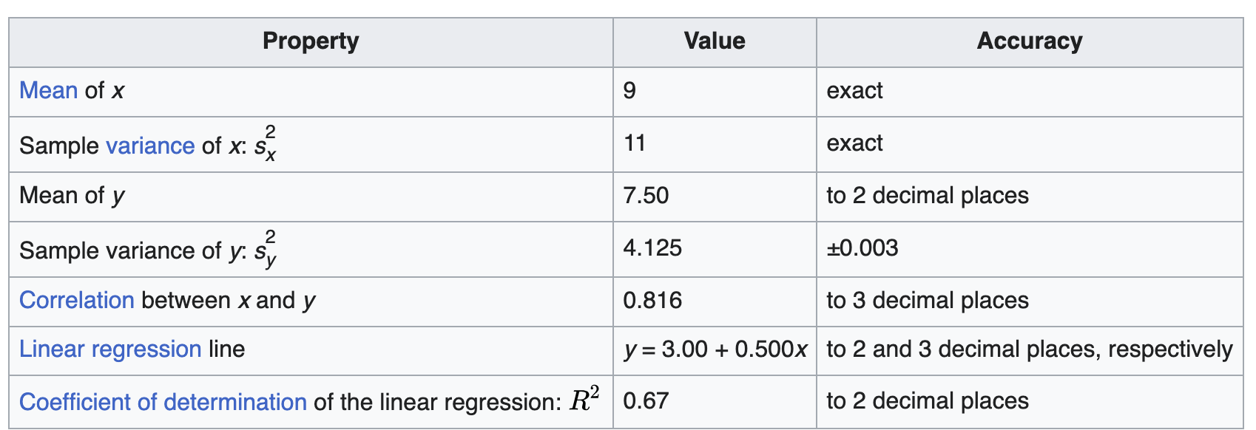
https://en.wikipedia.org/wiki/Anscombe%27s_quartet
Visualization – Trieste 2025
Notes:
Anscombe’s quartet is a set of four datasets that have nearly identical summary statistics, but very different visual patterns. This teaches us the importance of visualizing data instead of relying solely on summary statistics when exploring data

Slide 3
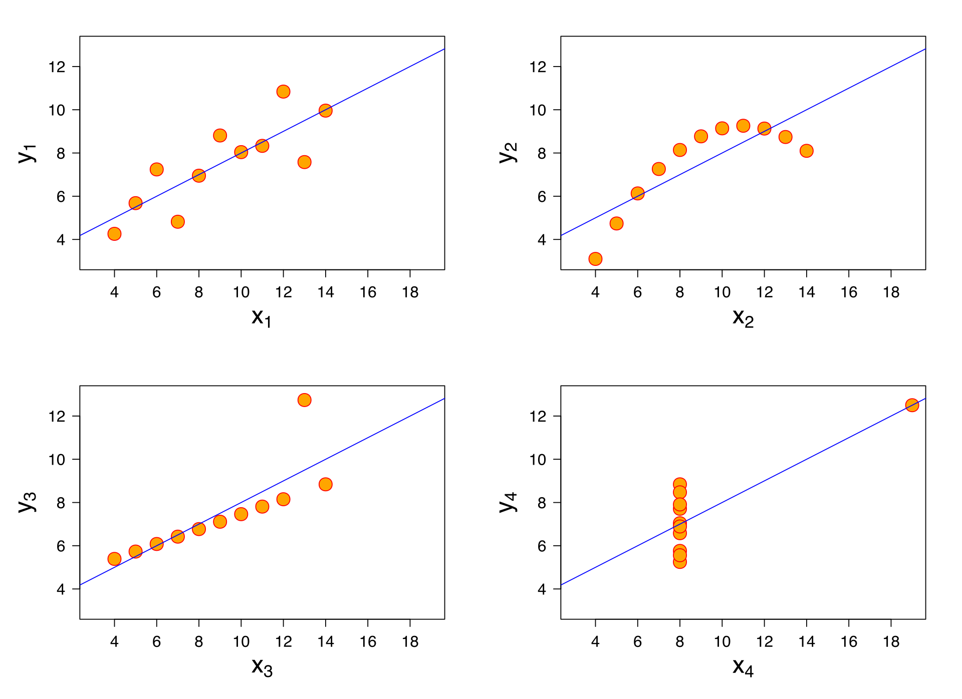
Anscombe's quartet comprises four data sets that have nearly identical simple descriptive statistics, yet have very different distributions and appear very different when graphed.
Each dataset consists of eleven (x,y) points.
https://en.wikipedia.org/wiki/Anscombe%27s_quartet
Visualization – Trieste 2025
Notes:
The objective of this problems set was to orient you to a number of activities and to conduct a thoughtful exercise in appreciating the importance of data viz
This teach us the importance of visualisation data instead of relying sollely on summary statistics when exploring data
Visualizing data can also help us identify errors or inconsistencies in our data. For example, if we see a scatterplot with a perfect linear relationship, this might indicate that the data is too good to be true and needs to be double-checked.
Understanding the importance of visualizing data can help us make better decisions and avoid making incorrect assumptions based on summary statistics alone. So next time you’re analyzing data, think like an artist and create a visualization to see the patterns in your data

Slide 4

Data Visualisation
Rob Quick
Director of the Cybersecurity Integration Research Center at Indiana University
Original Slide Deck Created by Dr. Sara El jadid<s.eljadid@qub.ac.uk>
CODATA-RDA Data Science School

Slide 5
Course Overview
Introduction
Overview
Good practices
Hands-on
Data types
ggplot2 tutorial
Graph types
The science of visualization
I
II
III
IV
Visualization – Trieste 2025

Slide 6
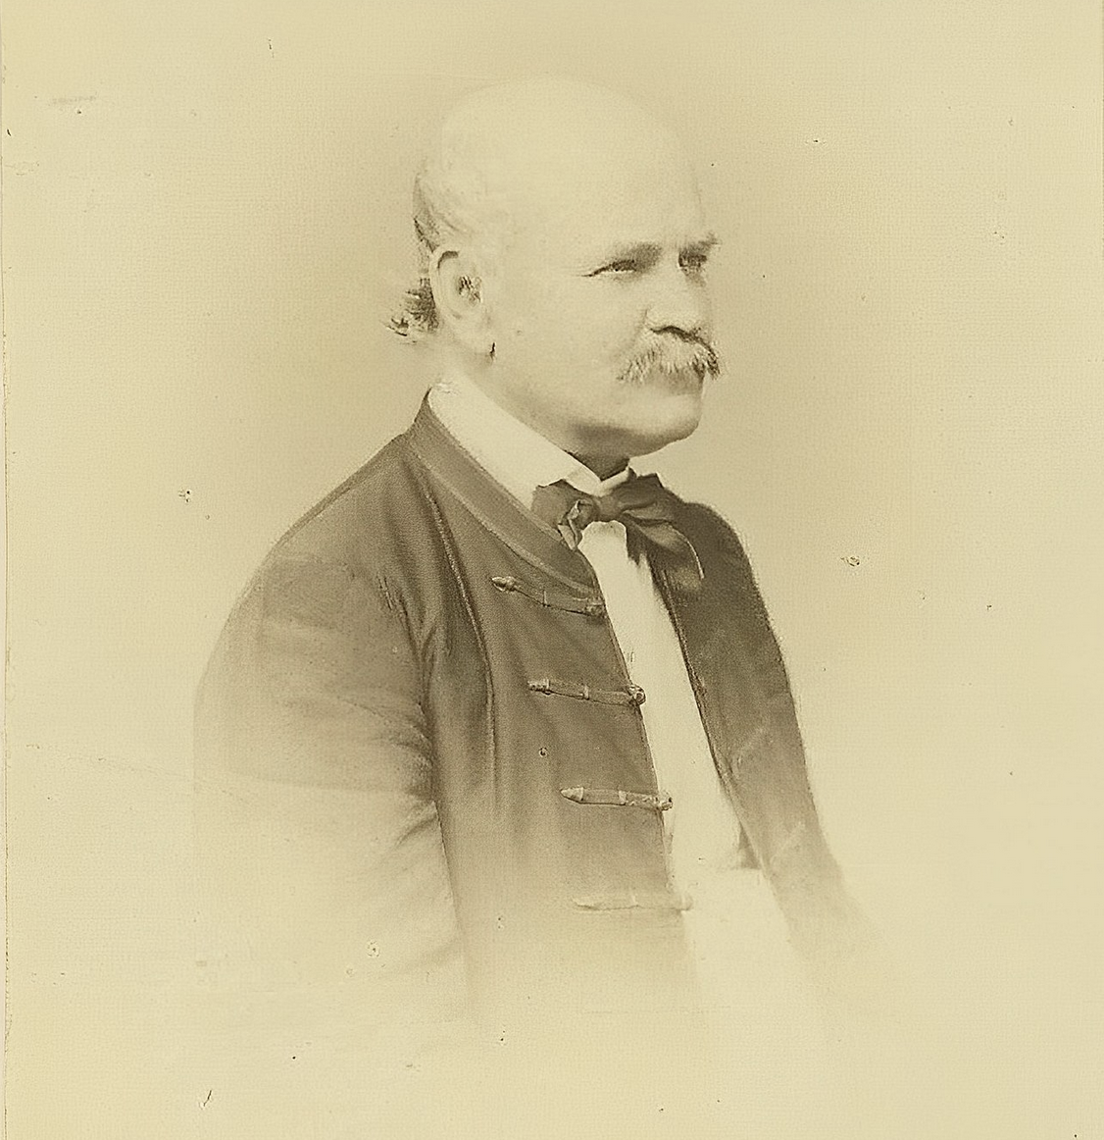
The Savior of Mothers
In 1846 Assistant Professor at a Vienna-based maternity hospital. Childbed fever was common and often fatal for mothers.
Leaning on his statistical training he made an alarming discovery, the doctor’s clinic mortality rate was much higher (9.9%), than the midwives’ clinic (3.9%).
Semmelweis introduced a new handwashing policy. Which led to immediate drops in mortality rates (2.2%) in the doctor’s clinic.
He couldn’t prove why his handwashing policy worked but assumed the data would speak for itself.
Rather than being praised for his discovery he was ridiculed and criticized by the doctors.
Visualization – Trieste 2025
Notes:
A Hungarian physician and scientist of German descent who was an early pioneer of antiseptic procedures and was described as the "saviour of mothers".^{[2]} Postpartum infection, also known as puerperal fever or childbed fever, consists of any bacterial infection of the reproductive tract following birth and in the 19th century was common and often fatal.
1. Healthy pregnant women would die shortly within a day or two of childbirth.
2. At the time there was no notion of germ theory or infections. So things like bad air, overcrowding, cold temps, and delivery methods were suspected. After another doctor at the clinic died shortly after receiving a minor injury when conducting an autopsy Semmelweis did the post-mortem examination and noticed the it had a strong similarity in the pathology.
It was common at that time for doctors to perform autopsies in the morning, then spend the rest of the day working with patients.
3. This low rate continued for the next several years, with some months have no fatalities for childbed fever.
4. Germ theory was still a few decades off… Mid 1860’s when Louis Pasture proposed Germ Theory.
5. The doctor’s could not accept that they were the cause of the problem. Voltaire once said “It is dangerous to be right in the matter on which the established authorities are wrong.”

Slide 7
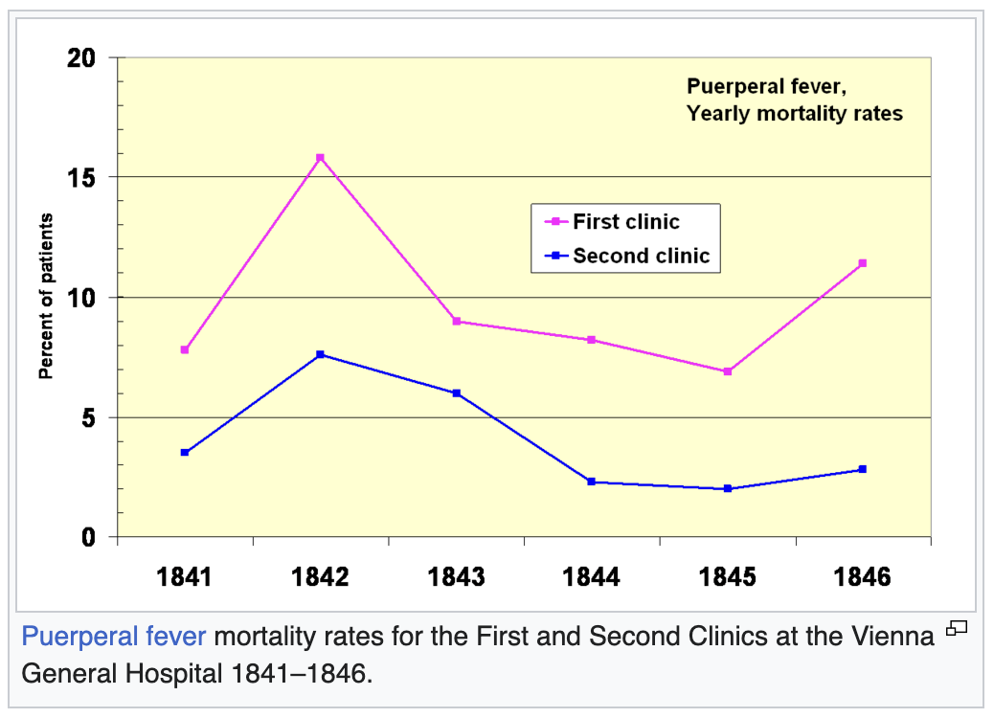
The Savior of Mothers
Semmelweis’ data was truthful, valuable, and actionable.
Despite this Semmelwies’ lifesaving techniques met resistance.
Semmelweis stated “I believed that I could leave it to time to break a path for the truth.”
What would have happened if Semmelweis had tried to humanize his data, not just let it speak for itself?
The book he published included more than 60 data tables but no data charts.
Visualization – Trieste 2025
Notes:
If he had introduced the issue by telling the story of Sophie a poor, but healthy, mother that showed up to the Vienna hospital expecting to return home with her third, but instead was in the clinics mortuary as a reminder of the high cost of childbed fever. Hindsight makes it easy to criticize mistakes from 150 years ago, but could have the right visualization and storytelling saved thousands of mothers between his observation and the introduction of germ theory?
I tell this story, to emphasize the importance of two things
visualization which we will spend the rest of the day talking about.
The importance for storytelling… the data tells you the observer a story (this is often times better seen when visualized), but it is the story you tell with the data you collect.

Slide 8
What’s Data Visualisation
Graphic representation of data that aims to communicate numerous heavy data in an efficient way that is easier to grasp and understand.
Data visualization describes any effort to help people understand the significance of data by placing it in a visual context.
A branch of Descriptive statistics but it requires both design, computer, and statistical skills.
Aesthetics and functionality go hand in hand to communicate complex statistics in an intuitive way.
Data Viz tools and technologies are essential for making data-driven decisions.
Visualization – Trieste 2025
Notes:
In a way, data visualization is the mapping between the original data and graphic elements that determine how the attributes of these elements vary

Slide 9
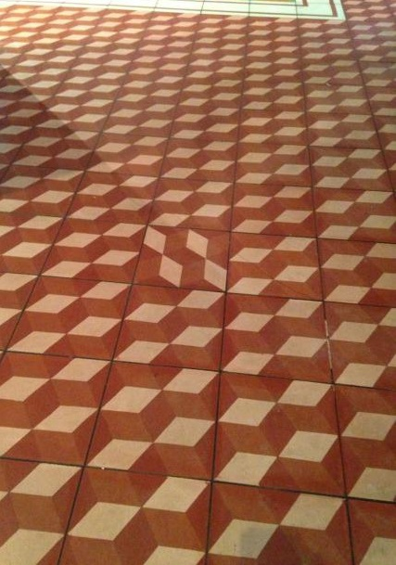
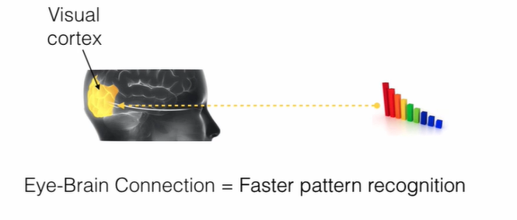
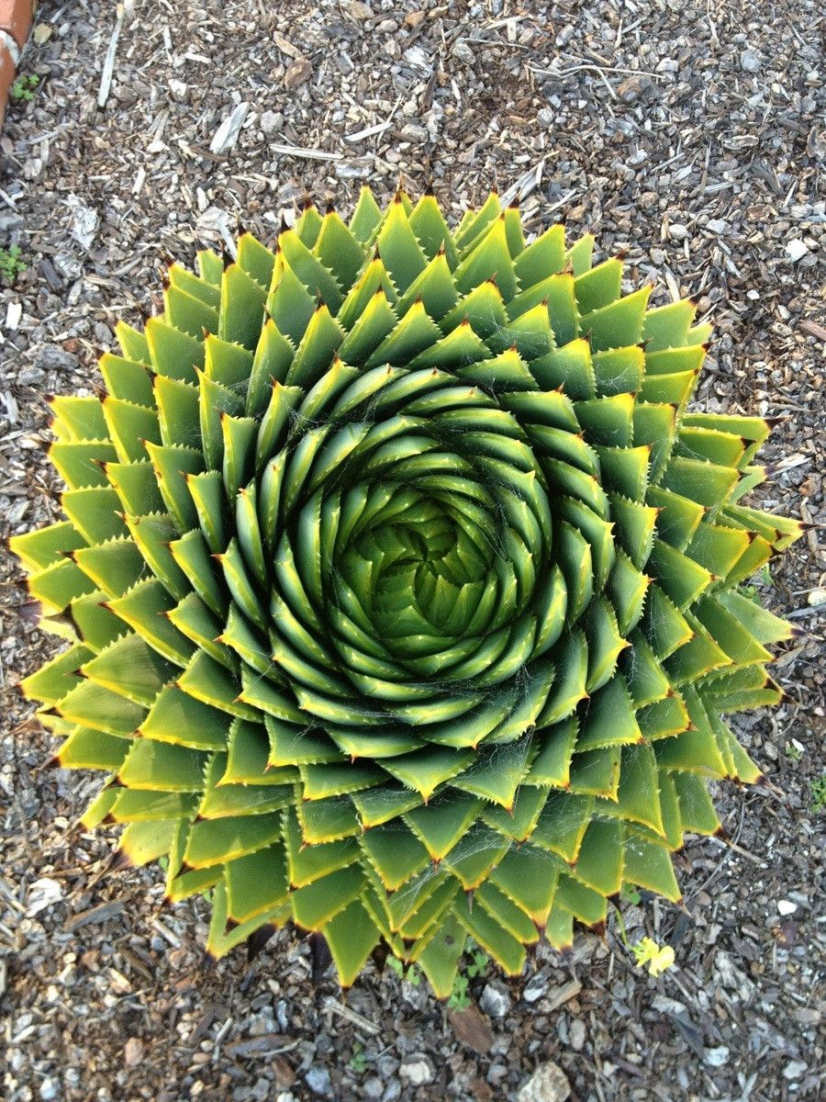
How does it work?
Humans are visual creatures, it’s a fact that visualization is much more effective and comprehensive.
Patterns, trends and correlations that might go undetected in text-based data can be exposed and recognized easier with data visualization software.
Visualization – Trieste 2025
Notes:
If we can see it, our brains can internalize and reflect on it. This is why it’s much easier and more effective to make sense of a chart and see trends than to read a massive document that would take a lot of time and focus to rationalize

Slide 10
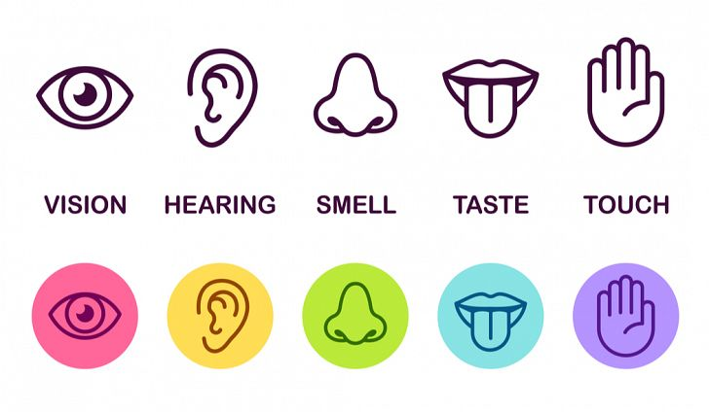
The sense of sight is the most dominant
Visualization – Trieste 2025

Slide 11
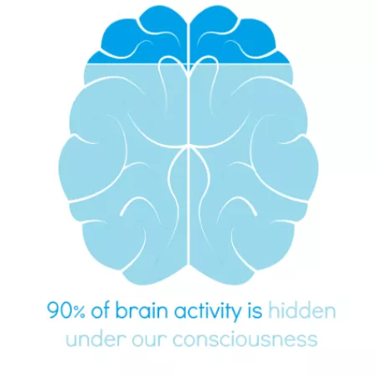



The sense of sight is the most dominant
90%
of information transmitted to the brain is visual
(sources: 3MCorporation and Zabisco )
40%
of people will respond better to visual information than to plain text
(source: Zabisco )
96.7%
believe than visual content engages best on social media
(source: Newburyport Mass )
Visualization – Trieste 2025

Slide 12

Why data visualization is important?
Data Viz is a form of storytelling with the purpose to help us make decisions based on data.
Tracking sales
Identifying trends
Identifying changes
Monitoring goals
Monitoring results
Combining data
Visualization – Trieste 2025
Notes:
In a way, we can say that data Viz is a form of storytelling with the purpose to help us make decisions based on data. Such data might include:

Slide 13
When to use it?
Data Viz is suitable for:
Annual reports
Presentations
Social media micronarratives
Informational brochures
Research
Trend-trafficking
SciViz
Candlestick chart for financial analysis
Determining routes
Visualization – Trieste 2025
Notes:
Data visualization is useful for companies that deal with lots of data on a daily basis. It’s essential to have your data and trends instantly visible. Better than scrolling through colossal spreadsheets.
When the trends stand out instantly this also helps your clients or viewers to understand them instead of getting lost in the clutter of numbers.

Slide 14
Why Use it?
Identifying correlations between the relationship of variables.
Getting market insights about audience behavior.
Determining value vs risk metrics.
Monitoring trends over time.
Examining rates and potential through frequency.
Ability to react to changes.
Visualization – Trieste 2025
Notes:
Short answer: decision making. Data Visualization comes with the undeniable benefits of quickly recognizing patterns and interpret data. More specifically, it is an invaluable tool to determine the following cases.

Slide 15

The four pillars of data visualization
Visualization – Trieste 2025

Slide 16
1. Purpose - why this visualization
For the creators:
Why am I doing this visualization?
Who is it for?
What do they need to understand?
What actions do you need to enable?
How it will be consumed?
What is the most important takeaway message?
PURPOSE
Visualization – Trieste 2025
Notes:
Preparation is half the work already done. Before you even start visualizing data, you have to be sure you understand that data to the last detail.

Slide 17
2. Content - what to visualize
What data matters?
What relationships (in the data) matter?
Informed by the purpose!
What’s excluded is as important as what’s included
PURPOSE
CONTENT
Visualization – Trieste 2025
Notes:
determine exactly what you want to communicate to the audience. What kind of information you’re visualizing and does it reflect your goal?

Slide 18
3. Structure - how to visualize it
How can the most important data and relationships be revealed the best?
Choose meaningful layout and axes!
Use both axes (both, not three..)
Informed by purpose and content!
PURPOSE
CONTENT
STRUCTURE
Visualization – Trieste 2025

Slide 19
4. Formatting - how to make it appealing
How it should look and feel?
How will it be consumed?
Makes data and relationships accessible
Makes importance visible
Informed by purpose, content and structure!
PURPOSE
CONTENT
STRUCTURE
FORMATTING
Visualization – Trieste 2025

Slide 20
Guide to data type
Variables
Qualitative
(categorical)
Quantitative
(numerical)
Ordinal
(can be ordered)
Satisfaction degree
Nominal
(can’t be ordered)
States region
Discrete
(limited value)
Children per family
Continuous
(unlimited value)
Height
Bar chart
Line chart
Histogram
Scatterplot
Boxplot
Bar chart
Pie chart
Bubble chart
Mode
(most frequent value)
Mean, sum & standard deviation
Mean, median, distribution, range & standard deviation
Visualization – Trieste 2025
Notes:
An important first step in deciding how to visualize data is to know what type of data it is.
We will be working with two types of variables—Quantitative(numericals) and Qualitative(categoricals)
Quantitative variables are numerical variables: counts, percents, or numbers.
Categorical variables are descriptions of groups or things, like “breeds of dog” or “voting preference”.
Each can be divided into two further groups. Categoricals can be divided into ordinals and nominals(non-ordinals). And numerical variables can be divided into discrete or continuous.
Some categorical data can be ordered. For example, spiciness can be mild, medium, or hot. Even if they are not numbers per se, they can still be ordered.
Nominal: Two simple examples are sex, male or female, or regions of the states Northeast, South, Central, West.
We can further divide numerical data into continuous and discrete. Continuous variables are those that can take any value such as heights if measured with enough precision
Counts such as population sizes are discrete because they have to be round numbers

Slide 21







Chart Types
Visualization – Trieste 2025

Slide 22
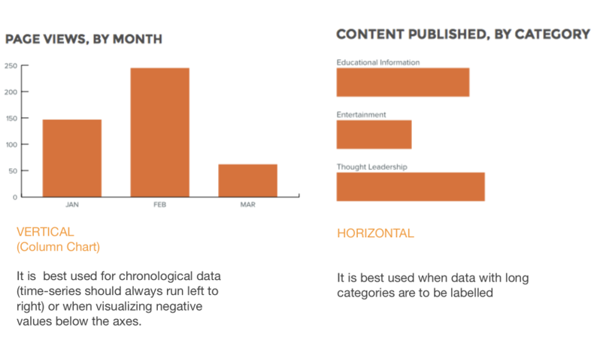
Bar chart
Bar charts are very versatile. They are best used to show change over time, compare different categories, or compare parts of a whole
Common Bar chart variations include Stacked, 100% stacked versions. Usually these variations are used to compare multiple part-to-whole relationships. i.e Monthly online traffic analysis by different sources.
Visualization – Trieste 2025

Slide 23
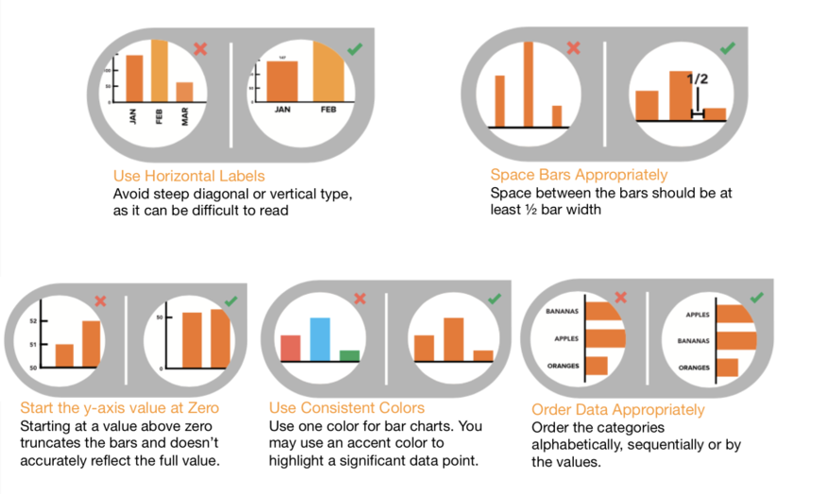
Bar chart best practices
Visualization – Trieste 2025

Slide 24
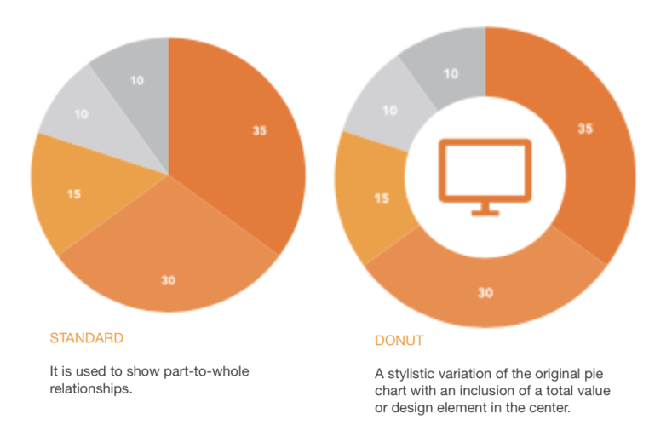
Pie chart
Pie charts are best used for making portion to whole comparisons with discrete or continuous data. They are most impactful with a small data set.
Visualization – Trieste 2025

Slide 25
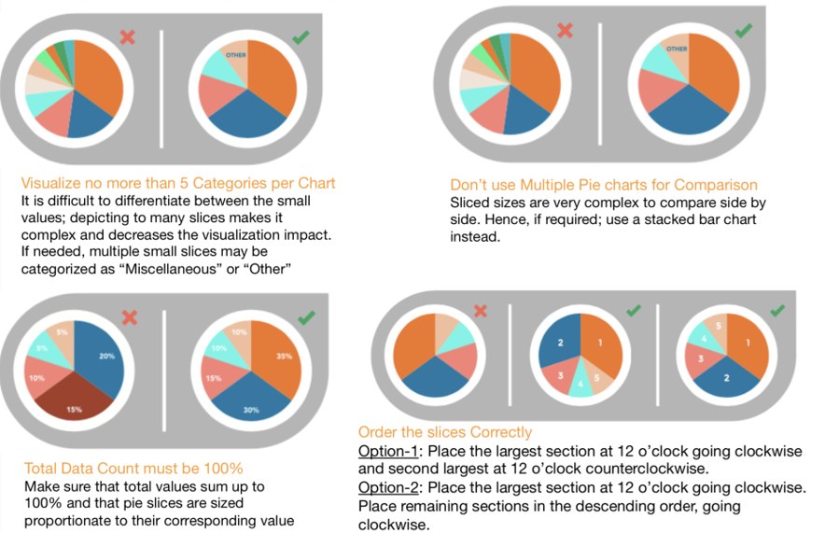
Pie chart best practices
Visualization – Trieste 2025

Slide 26
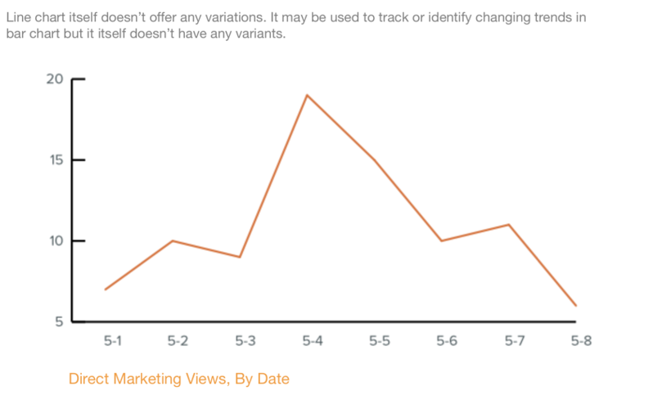
Line chart
Line charts are used to show time-series relationships with continuous data. They help show trend, acceleration, deceleration, and volatility.
Visualization – Trieste 2025

Slide 27
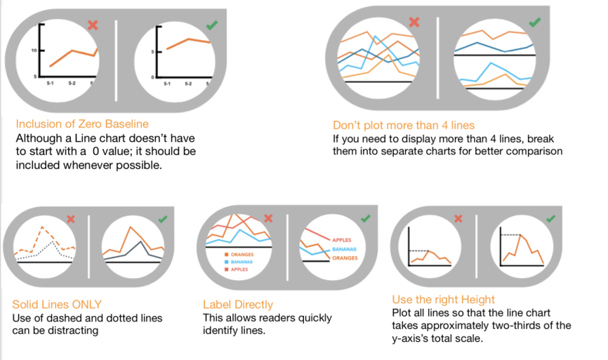
Line chart best practices
Visualization – Trieste 2025

Slide 28
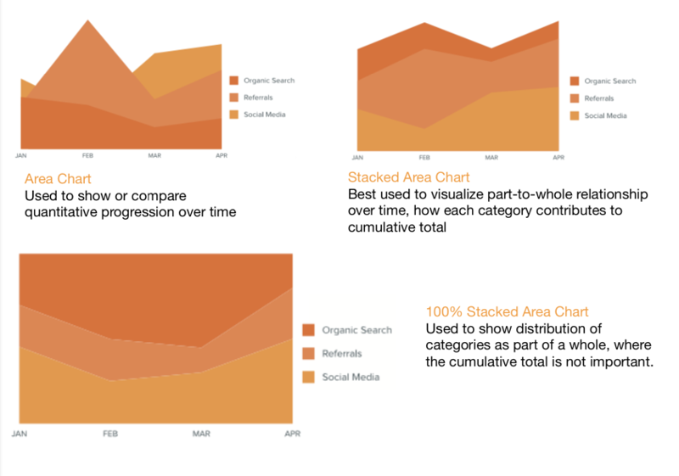
Area chart
Area charts depict a time-series relationship, but they are different than line charts in that they can represent volume.
Visualization – Trieste 2025

Slide 29
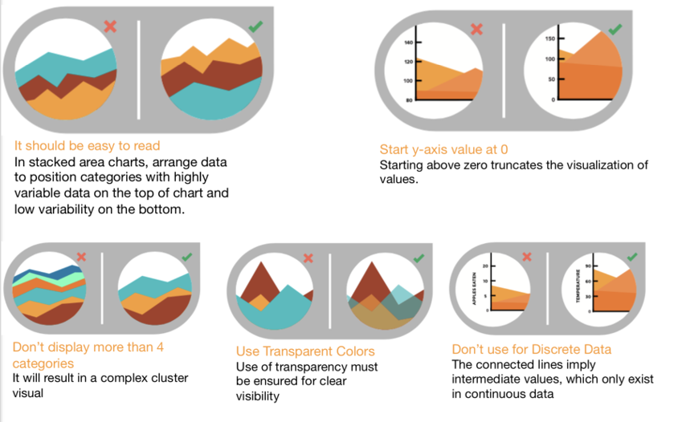
Area chart best practices
Visualization – Trieste 2025

Slide 30
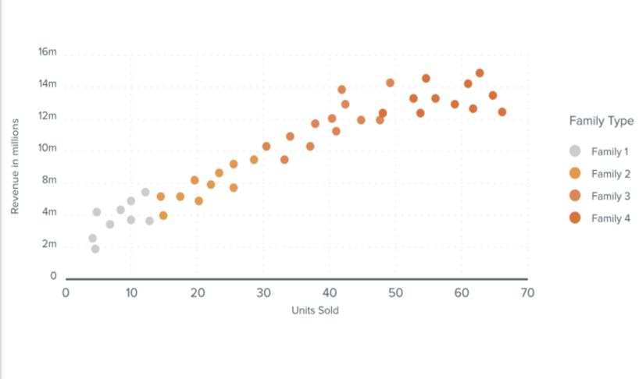
Scatterplot chart
Scatter plots show the relationship between items based on two sets of variables. They are best used to show correlation in a large amount of data.
Visualization – Trieste 2025

Slide 31
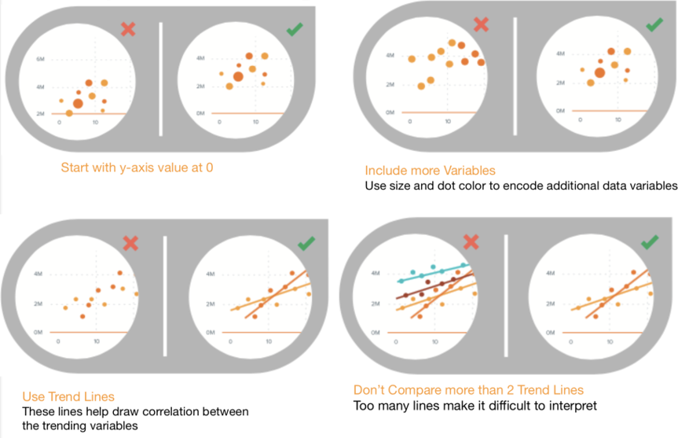
Scatterplot chart best practices
Visualization – Trieste 2025

Slide 32
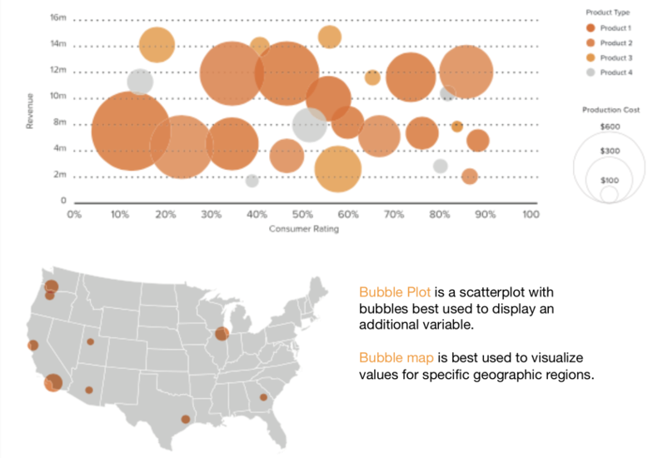
Bubble chart
Bubble charts are good for displaying nominal comparisons or ranking relationships.
Visualization – Trieste 2025

Slide 33
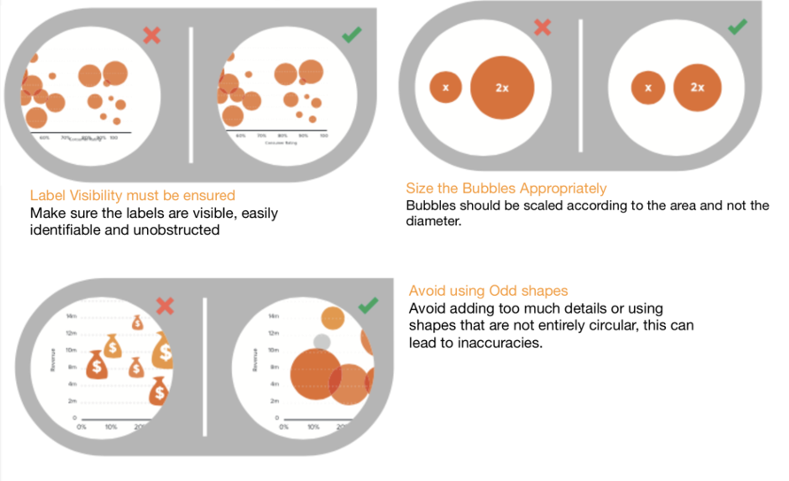
Bubble chart best practices
Visualization – Trieste 2025

Slide 34
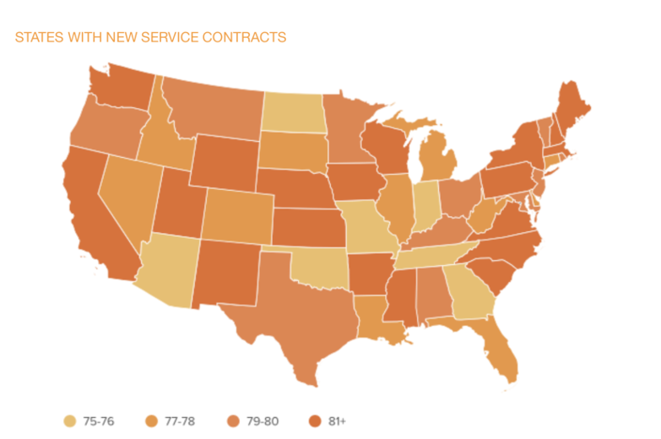
Heat Map
Heat maps are used to display categorical data, using intensity of color to represent values of geographic areas or data tables.
Visualization – Trieste 2025

Slide 35
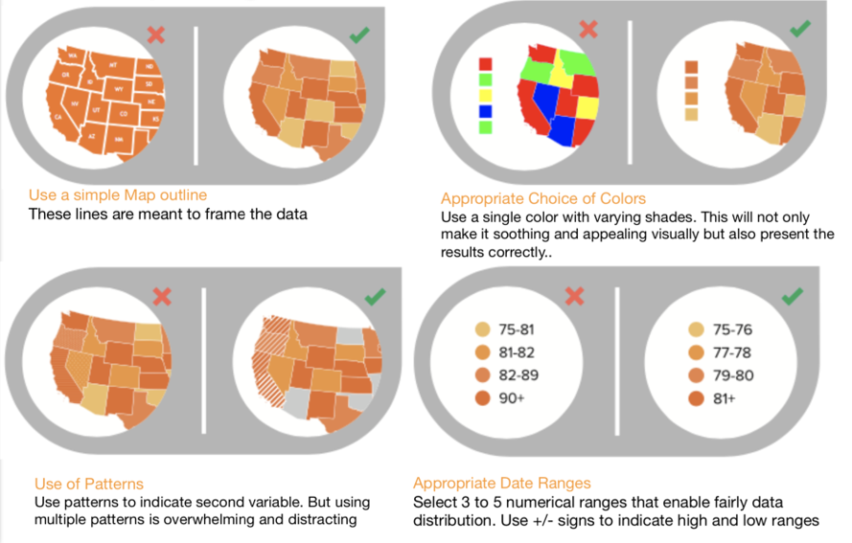
Heat Map best practices
Visualization – Trieste 2025

Slide 36

Important Tips
Visualization – Trieste 2025

Slide 37
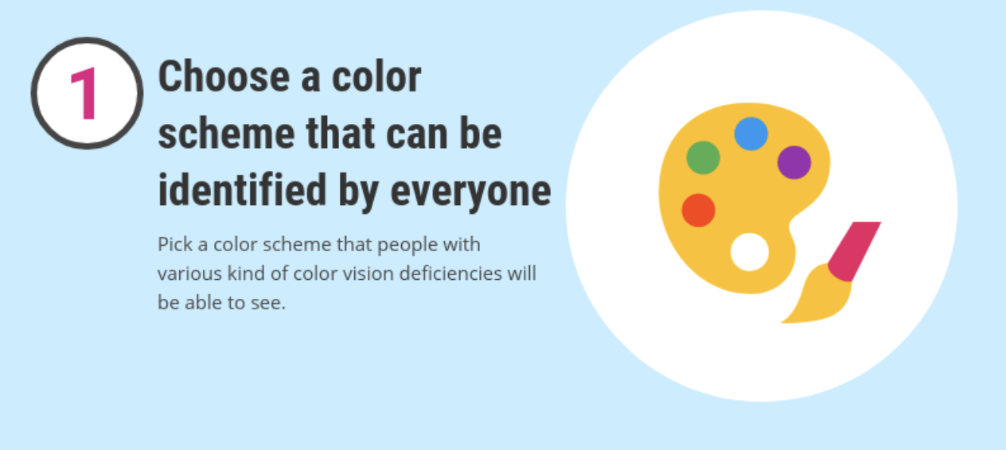
Choice of colors – use color blind friendly palette
http://www.cookbook-r.com/Graphs/Colors_(ggplot2)/#a-colorblind-friendly-palette
Visualization – Trieste 2025

Slide 38
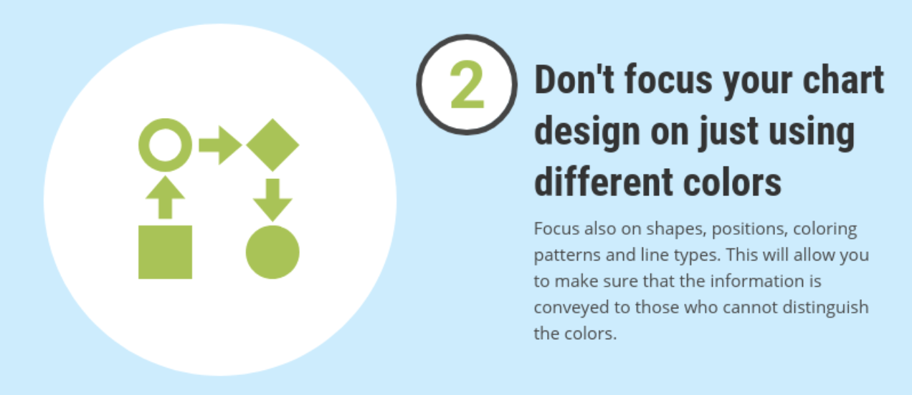
Choice of colors – use color blind friendly palette
Visualization – Trieste 2025

Slide 39

Choice of colors – use color blind friendly palette
Visualization – Trieste 2025

Slide 40
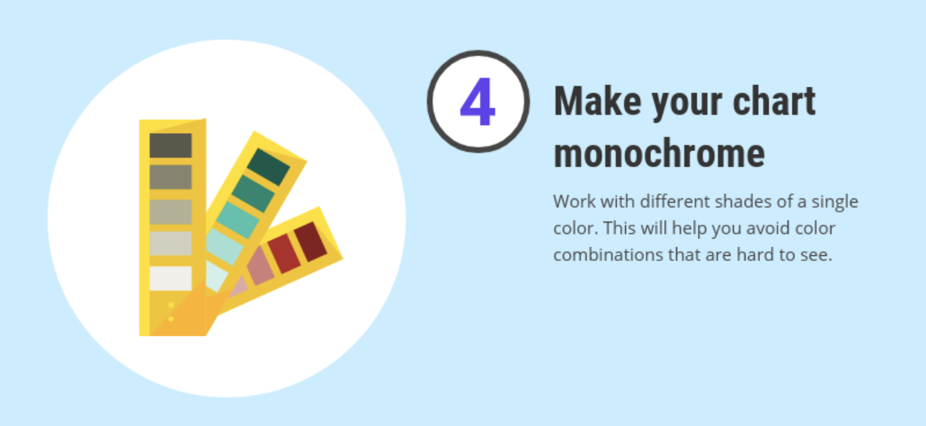
Choice of colors – use color blind friendly palette
Visualization – Trieste 2025

Slide 41
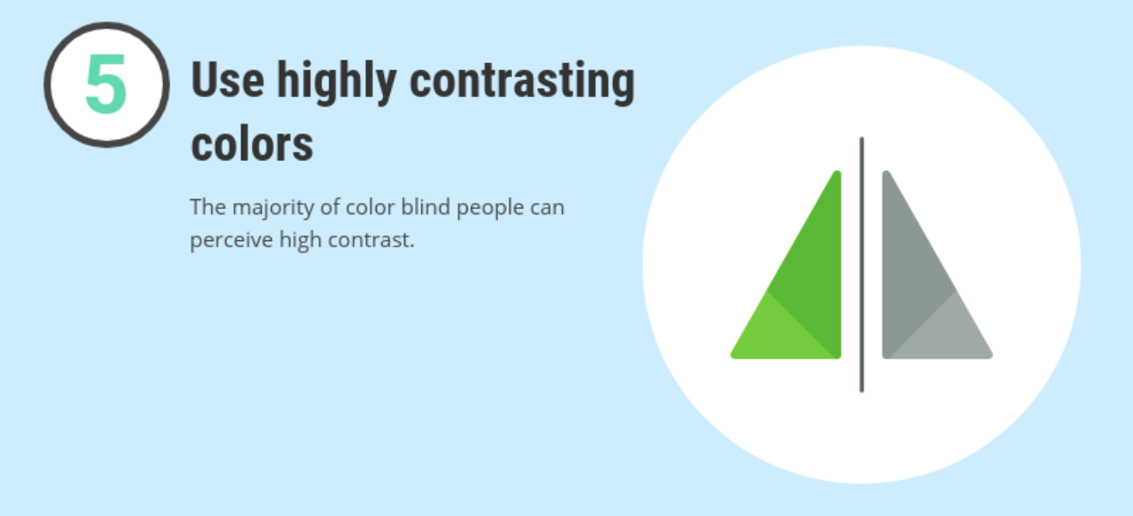
Choice of colors – use color blind friendly palette
Visualization – Trieste 2025

Slide 42
Do’s and don’ts in data design & visualization
Use one color to present each category.
Use order data sets using logical hierarchy.
Use high contrast color combinations such as Red/Green or Blue/Yellow.
Use callouts to highlight important or interesting information.
Use 3D charts.
Visualize your data in a way that it’s easy for readers to compare values.
Add chart junk.
Use more than 6 colors in a single layout.
Use icons to enhance comprehension.
Use italic, bold or underline text.
Visualization – Trieste 2025

Slide 43

Do’s and don’ts in data design & visualization
Use one color to present each category.
Order data sets using logical hierarchy.
Use high contrast color combinations such as Red/Green or Blue/Yellow.
Use callouts to highlight important or interesting information.
Use 3D charts.
Visualize your data in a way that it’s easy for readers to compare values.
Add chart junk.
Use more than 6 colors in a single layout.
Use icons to enhance comprehension.
Use italic, bold or underline text.
Visualization – Trieste 2025

Slide 44
Do’s and don’ts in data design & visualization
Use one color to present each category.
Order data sets using logical hierarchy.
Use high contrast color combinations such as Red/Green or Blue/Yellow.
Use callouts to highlight important or interesting information.
Use 3D charts.
Visualize your data in a way that it’s easy for readers to compare values.
Add chart junk.
Use more than 6 colors in a single layout.
Use icons to enhance comprehension.
Use italic, bold or underline text.
Visualization – Trieste 2025

Slide 45

Do’s and don’ts in data design & visualization
Use one color to present each category.
Order data sets using logical hierarchy.
Use high contrast color combinations such as Red/Green or Blue/Yellow.
Use callouts to highlight important or interesting information.
Use 3D charts.
Visualize your data in a way that it’s easy for readers to compare values.
Add chart junk.
Use more than 6 colors in a single layout.
Use icons to enhance comprehension.
Use italic, bold or underline text.
Visualization – Trieste 2025

Slide 46
Do’s and don’ts in data design & visualization
Use one color to present each category.
Order data sets using logical hierarchy.
Use high contrast color combinations such as Red/Green or Blue/Yellow.
Use callouts to highlight important or interesting information.
Use 3D charts.
Visualize your data in a way that it’s easy for readers to compare values.
Add chart junk.
Use more than 6 colors in a single layout.
Use icons to enhance comprehension.
Use italic, bold or underline text.
Visualization – Trieste 2025

Slide 47
Do’s and don’ts in data design & visualization
Use one color to present each category.
Order data sets using logical hierarchy.
Use high contrast color combinations such as Red/Green or Blue/Yellow.
Use callouts to highlight important or interesting information.
Use 3D charts.
Visualize your data in a way that it’s easy for readers to compare values.
Add chart junk.
Use more than 6 colors in a single layout.
Use icons to enhance comprehension.
Use italic, bold or underline text.
Visualization – Trieste 2025

Slide 48
Do’s and don’ts in data design & visualization
Use one color to present each category.
Order data sets using logical hierarchy.
Use high contrast color combinations such as Red/Green or Blue/Yellow.
Use callouts to highlight important or interesting information.
Use 3D charts.
Visualize your data in a way that it’s easy for readers to compare values.
Add chart junk.
Use more than 6 colors in a single layout.
Use icons to enhance comprehension.
Use italic, bold or underline text.
Visualization – Trieste 2025

Slide 49
Do’s and don’ts in data design & visualization
Use one color to present each category.
Order data sets using logical hierarchy.
Use high contrast color combinations such as Red/Green or Blue/Yellow.
Use callouts to highlight important or interesting information.
Use 3D charts.
Visualize your data in a way that it’s easy for readers to compare values.
Add chart junk.
Use more than 6 colors in a single layout.
Use icons to enhance comprehension.
Use italic, bold or underline text.
Visualization – Trieste 2025

Slide 50
Do’s and don’ts in data design & visualization
Use one color to present each category.
Order data sets using logical hierarchy.
Use high contrast color combinations such as Red/Green or Blue/Yellow.
Use callouts to highlight important or interesting information.
Use 3D charts.
Visualize your data in a way that it’s easy for readers to compare values.
Add chart junk.
Use more than 6 colors in a single layout.
Use icons to enhance comprehension.
Use italic, bold or underline text.
Visualization – Trieste 2025

Slide 51
Do’s and don’ts in data design & visualization
Use one color to present each category.
Order data sets using logical hierarchy.
Use high contrast color combinations such as Red/Green or Blue/Yellow.
Use callouts to highlight important or interesting information.
Use 3D charts.
Visualize your data in a way that it’s easy for readers to compare values.
Add chart junk.
Use more than 6 colors in a single layout.
Use icons to enhance comprehension.
Use italic, bold or underline text.
Visualization – Trieste 2025

Slide 52
Do’s and don’ts in data design & visualization
Use one color to present each category.
Order data sets using logical hierarchy.
Use high contrast color combinations such as Red/Green or Blue/Yellow.
Use callouts to highlight important or interesting information.
Use 3D charts.
Visualize your data in a way that it’s easy for readers to compare values.
Add chart junk.
Use more than 6 colors in a single layout.
Use icons to enhance comprehension.
Use italic, bold or underline text.
Visualization – Trieste 2025

Slide 53

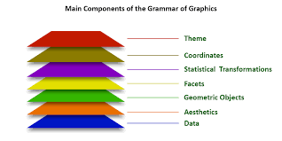

Next part: Tutorial
Visualization – Trieste 2025

Slide 54
Plotting libraries
Matplotlib is the most basic and widely-used Python library for creating static, animated, and interactive visualisations. It provides a lot of control over every aspect of a plot.
Seaborn is built on top of Matplotlib and provides a high-level interface for creating attractive and informative statistical graphics.
Plotnine is a Python implementation of the Grammar of Graphics (similar to R’s ggplot2). It provides a high-level abstraction for creating complex plots by layering components.
Visualization – Trieste 2025

Slide 55
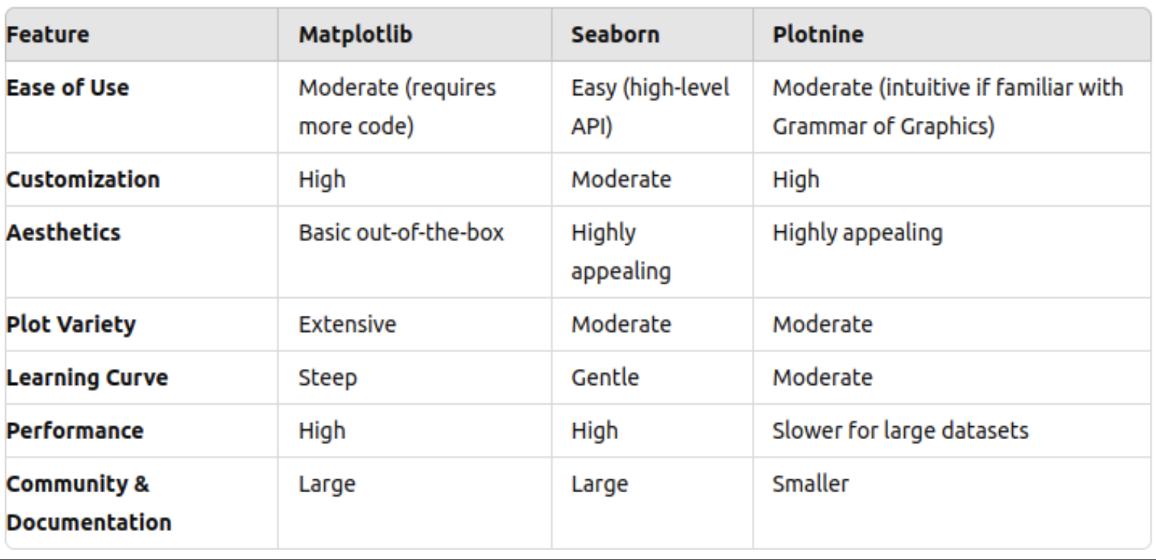
Plotting libraries
Visualization – Trieste 2025

Slide 56
Grammar of graphics
Grammar of graphics = a framework which follows a layered approach to describe and construct visualisations or graphics in a structured manner
plot = data + aesthetics + geometry
<data> = refers to a data frame (data set)
<aesthetics> = indicates x and y variables & how data should be displayed in the plot (e.g. color, size, shape)
<geometry> = refers to the type of graphics (bar chart, histogram, box plot, line plot, density plot, etc.)
Visualization – Trieste 2025

Slide 57
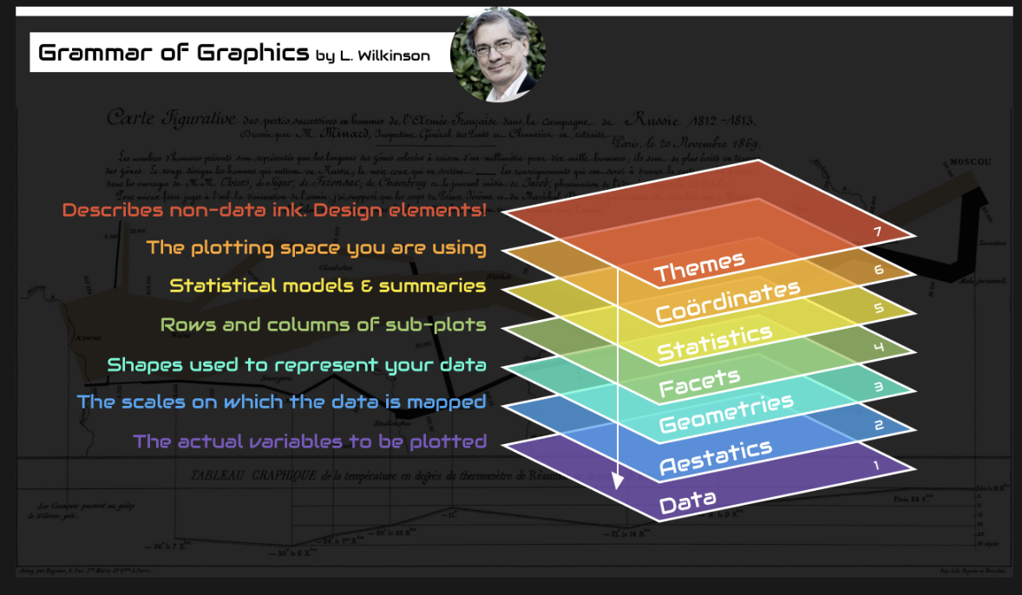
Grammar of graphics
Visualization – Trieste 2025

Slide 58
Data Visualisation
A picture is worth a thousand of words
Thank You
CODATA-RDA Data Science School

